Slide 1
AMSAT-NA
PACSAT-Dev
Real Time
Clock
SPI
RX1
2M ANT
2 WatchDogs
RX2
Power
Divider
PreAMP
Filter
RX3
Sensors
RX4
70 CM ANT
Filter
2W AMP
TX
Power
-2V, 1.2V, 3.3V, 5V
Current Control
Memory
CPU
I2C
Notes:
The Moon is sometimes called OSCAR-0
1

Slide 2
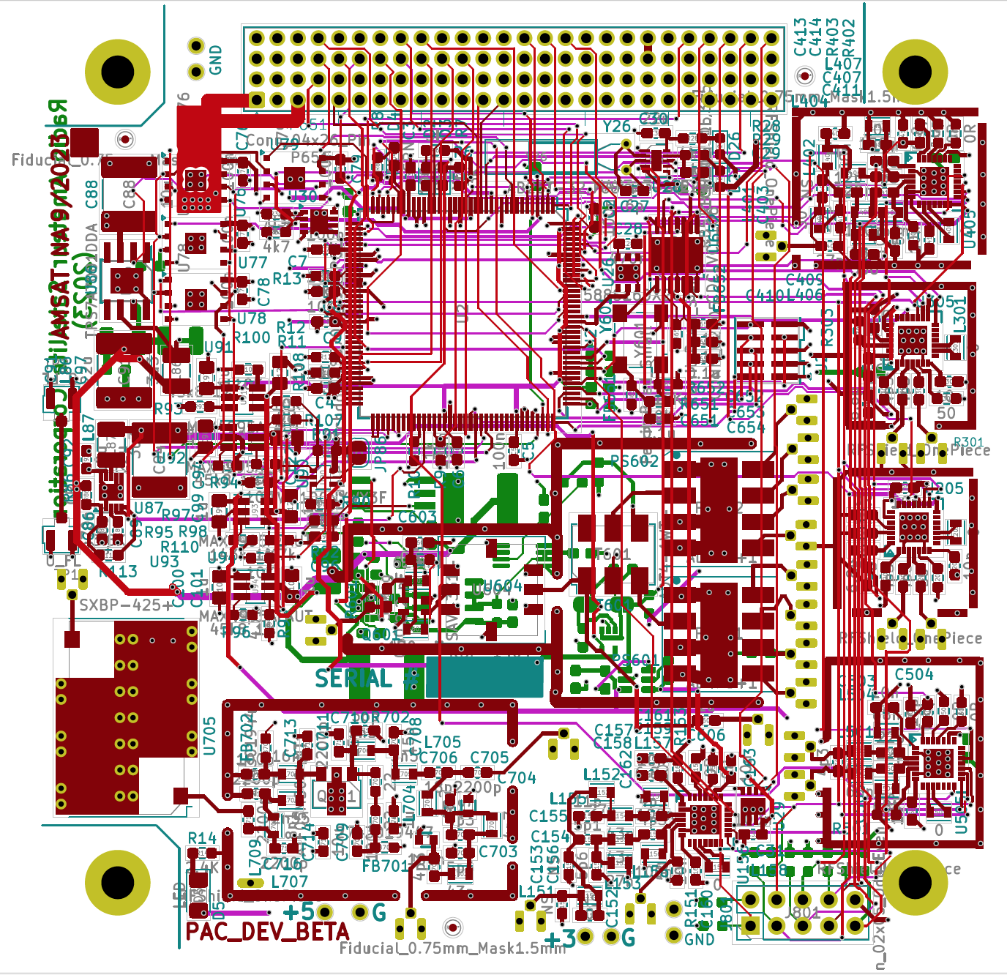
AMSAT-NA
PACSAT-Dev
CubeSat Format
Six Layer PCB
Produced with KiCad 7.0
300+ components
Notes:
The Moon is sometimes called OSCAR-0
2

Slide 3
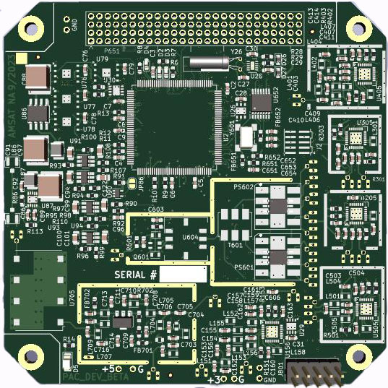
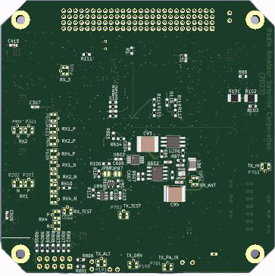
AMSAT-NA
PACSAT-Dev
Notes:
The Moon is sometimes called OSCAR-0
3

